Slide 1


Find Your Fit
Post-High School Education:
2 Year vs. 4 Year School?

Slide 2

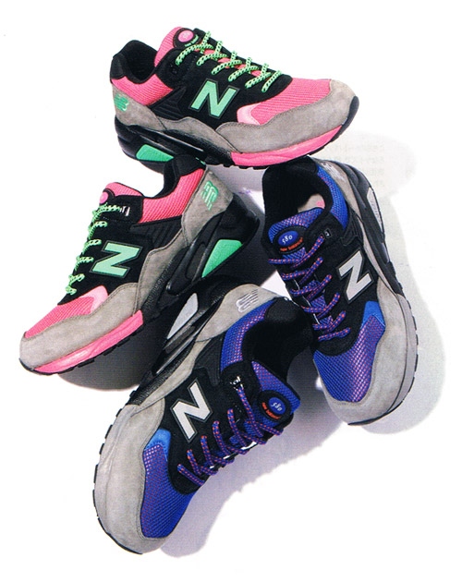
Questions to ask yourself…
Why do you want to go to college?
What career are you pursuing?
What is the job outlook on your choice?

Slide 3

Financial Considerations
Earning power per year:
  High school diploma: $33,801
  Associate degree: $42,000
  Bachelor’s degree: $55,600
  Master’s degree: $67,000
  Doctorate: $100,000+
U.S. Census Bureau 2008 median earnings

Slide 4

WI Post-Secondary Options
    2-Year
Technical College System
Private Tech Schools
  4-Year
UW System
Private Colleges

Slide 5

WI Technical College System
MATC (Madison College), Fox Valley Tech, etc.
  Focus more on technical skills rather than theory.
  Hands-on training.
  Instructors have experience working in their field.
  Enter the job market in 2 years*
  Training for some of fastest growing occupations.
  Tuition cost: approx. $2,500/semester
  No on-campus housing
  Less debt
  COMPASS/Placement Test required
    *Scores determine placement in program

Slide 6
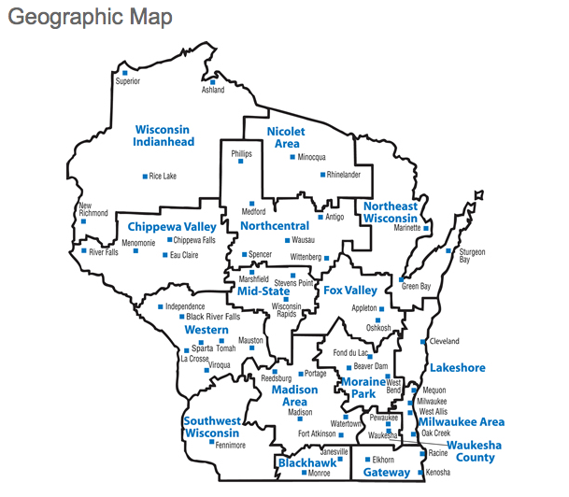
Wisconsin
Technical
Colleges

Slide 7

Private Technical Colleges
Herzing College – Madison
ITT Tech – Madison, various locations
WyoTech – various locations
Benefits:
  Compressed programs
  Job-specific
  Some run year-round
Cost: 3-4X state technical
college
**Credits may not transfer

Slide 8

Why students choose Tech College
Want to begin working/earning sooner
Want to graduate with less debt
Know what career they want
Want hands-on, relevant curriculum
Want a direct path to their career future
Need flexible learning options
Opportunity to transfer to a 4-year college
WI Tech College System website

Slide 9
Top Paying Technical Jobs
Computer Specialist $59,000
Nuclear Technician $59,000
Dental Hygienist $58,000
Radiology Tech $57,500
Registered Nurse $52,300
Engineering Technician $49, 400
According to CNN magazine

Slide 10
UW System College
Broad, liberal arts curriculum
Less flexible schedule
On-campus housing
Large variety of program majors
Large variety on-campus activities/clubs
Competitive atmosphere
ACT required for admission (Plus Writing?)
Cost: Tuition is about $11,000/yr
  Not including Dorms, Food, Books, etc…

Slide 11

UW System Colleges
UW- Eau Claire
UW-Green Bay
UW-LaCrosse
UW-Madison
UW-Milwaukee
UW-Oshkosh
UW-Parkside
UW-Platteville
UW-River Falls
UW-Stevens Point
UW-Stout
UW-Superior
UW-Whitewater

Slide 12

UW-Baraboo
Part of the UW System
Freshman and sophomore years of a bachelor’s program
Small class size
Tuition cost: $4,268/yr
Guaranteed Transfer Program to 4-yr campus

Slide 13

Private Colleges
Small class sizes
Opportunity for more in-class participation
Networking (alumni) and personal ties
Admissions may be more flexible
Merit-based aid for top students
Make their own rules and set their own educational models
May have a religious affiliation
Cost: $28,000/yr tuition

Slide 14

WI Private Colleges
Alverno College
Beloit College
Cardinal Stritch University
Carroll University
Carthage College
Concordia University
Edgewood College
Lakeland College
Lawrence University
Marian University
Marquette University
Milwaukee Art Institute
Milwaukee School of Engineering
Mount Mary College
Northland College
Ripon College
St. Norbert College
Silver Lake College
Viterbo University
WI Lutheran College

Slide 15

Why Earn a Bachelor’s Degree?
Investment in your future
Increases your professional options
  Graduate school/master’s degree
Opportunity to earn more over lifetime
Required for certain occupations

Slide 16

Careers That Require Bachelor’s Degree
Teacher: Kindergarten – H.S. $42,000
Architect - $53,000
Engineer - $60,000
Accountant/Auditor - $55,000
Computer Systems Analyst $68,000

Slide 17

Why students don’t attend college
Can’t afford it
Nobody in their family has gone
Don’t know what they want to study
College might be too hard
Fear of not fitting in

Slide 18
Affording College
              There is money available:
                Grants
                Loans
                Scholarships
Attend our seminar on March 22 during Advisory

Slide 19
Nobody in my family attended
Find an adult mentor
  Teacher, friend’s parents, someone working in your prospective field/major
Research online and educate yourself
Having a general idea is often enough
  Interest in math/science; helping people; business world
Utilize WISCareers and other career sites
I don’t know what I want to study

Slide 20
College might be too hard…
Start at a technical college campus to build skills
  Academic
  Study habits
  Self motivation
  Time management
Utilize tutoring services available on any campus
Attend part-time

Slide 21
Transition 2 yr to 4 year programs
MATC (Madison College) partners with:
  UW – LaCrosse - Edgewood College
  UW – Madison - Carroll University
  UW – Milwaukee - Concordia University
  UW – Platteville - Franklin University
  UW – River Falls - Kaplan University
  UW – Stout - Lakeland College
  UW – Whitewater - Milwaukee School of Engineering

Slide 22
Where do I go from here?
Talk to Counselors & Teachers
Go on college visits
Talk to admissions counselors visiting PHS
Explore college websites
Log on to WISCareers
Attend our other seminars:
March 1 – Choosing a College
March 8 – Making the Most of Your College Visit
March 22 – Financing College Education
April 5 – ACT Prep Workshop
April 12 – Madison College/ COMPASS Test Prep

